Slide 1
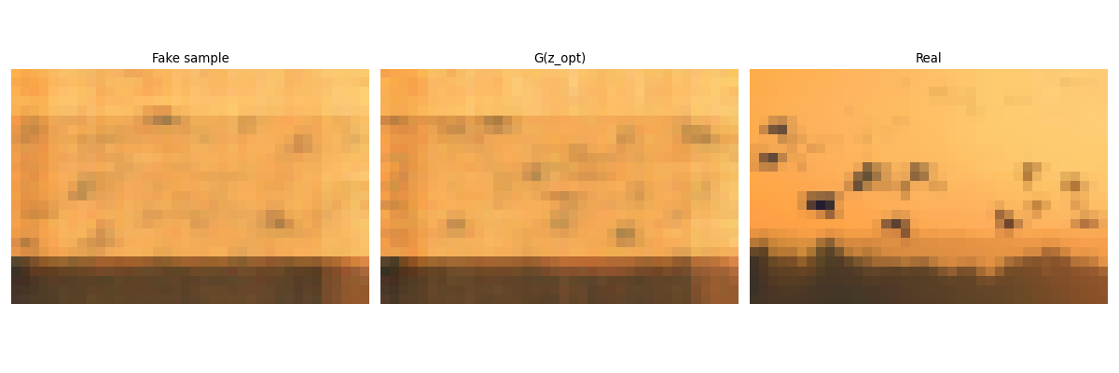
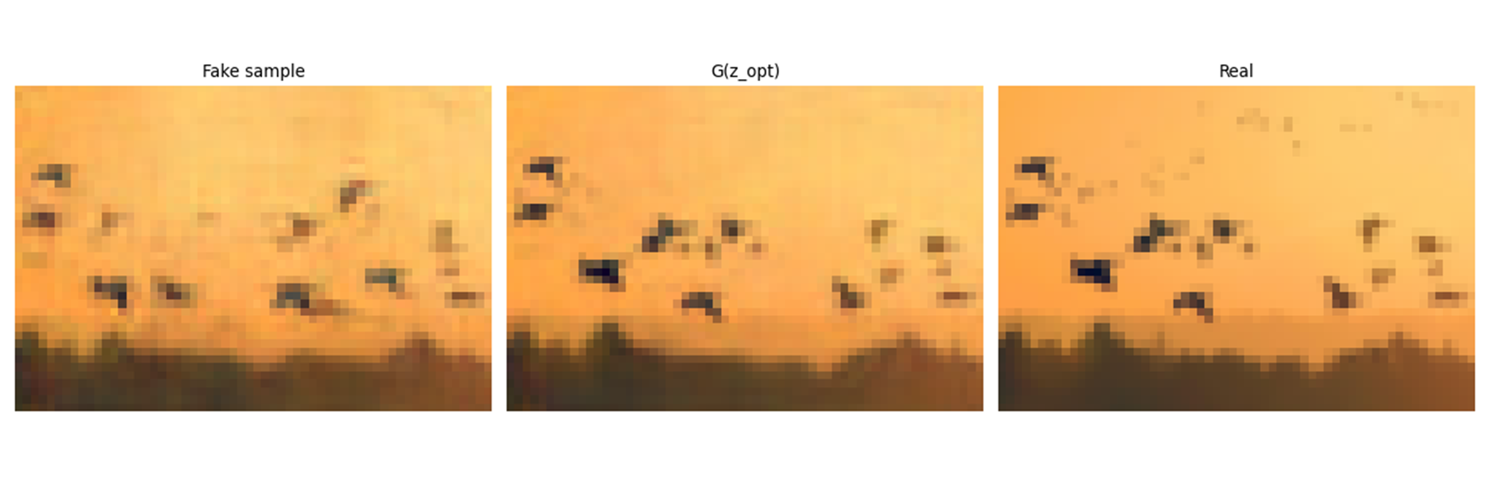
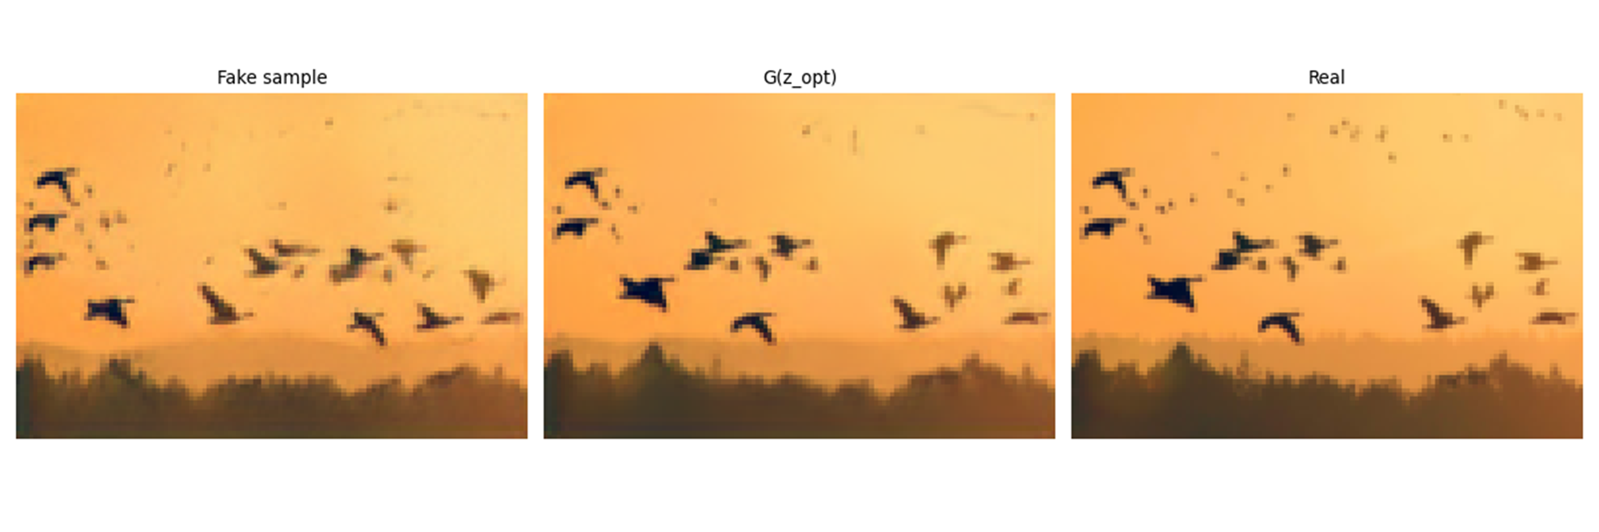
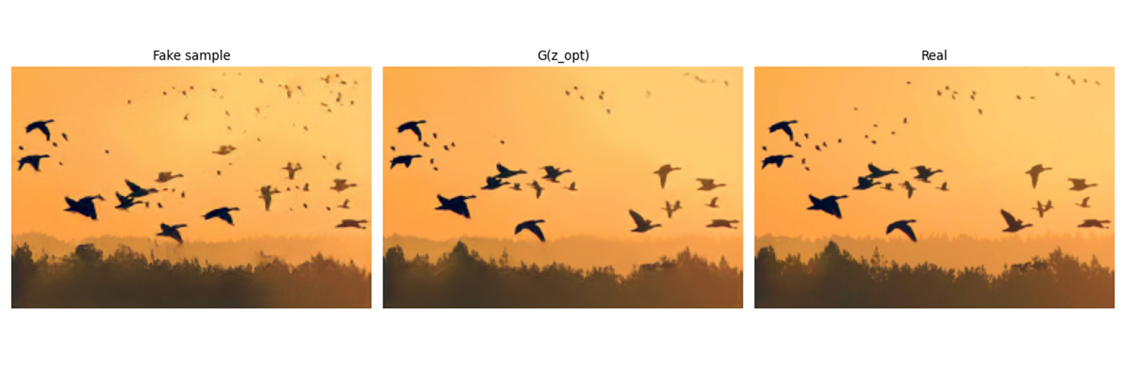
RESULTS : IMAGE GENERATION QUALITATIVE ANALYSIS Default SinGAN
0
2
5
8

Slide 2
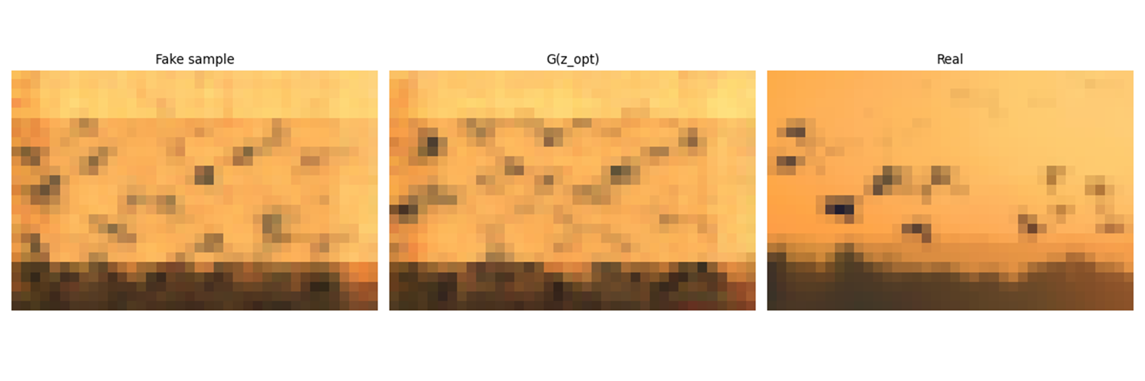
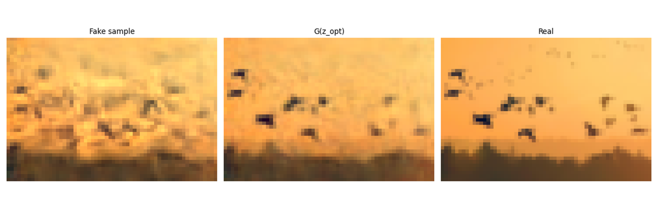
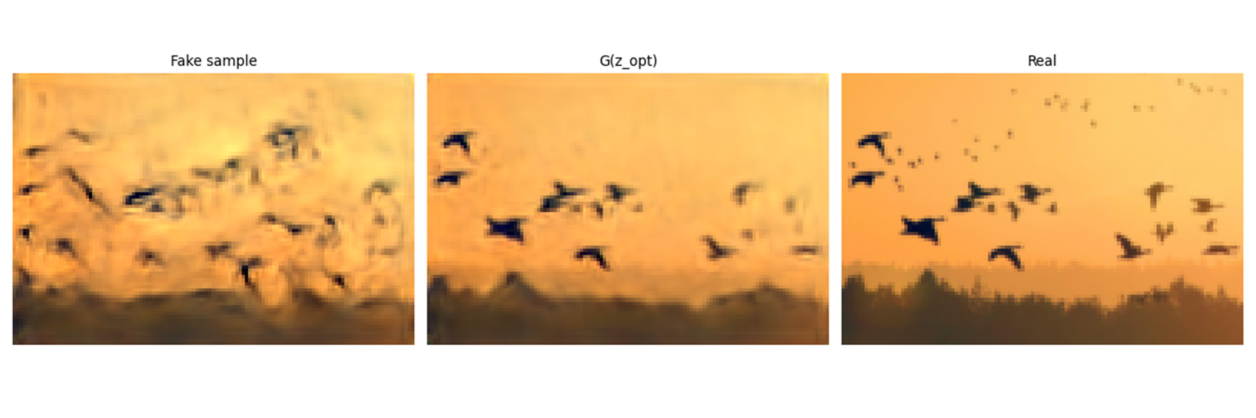
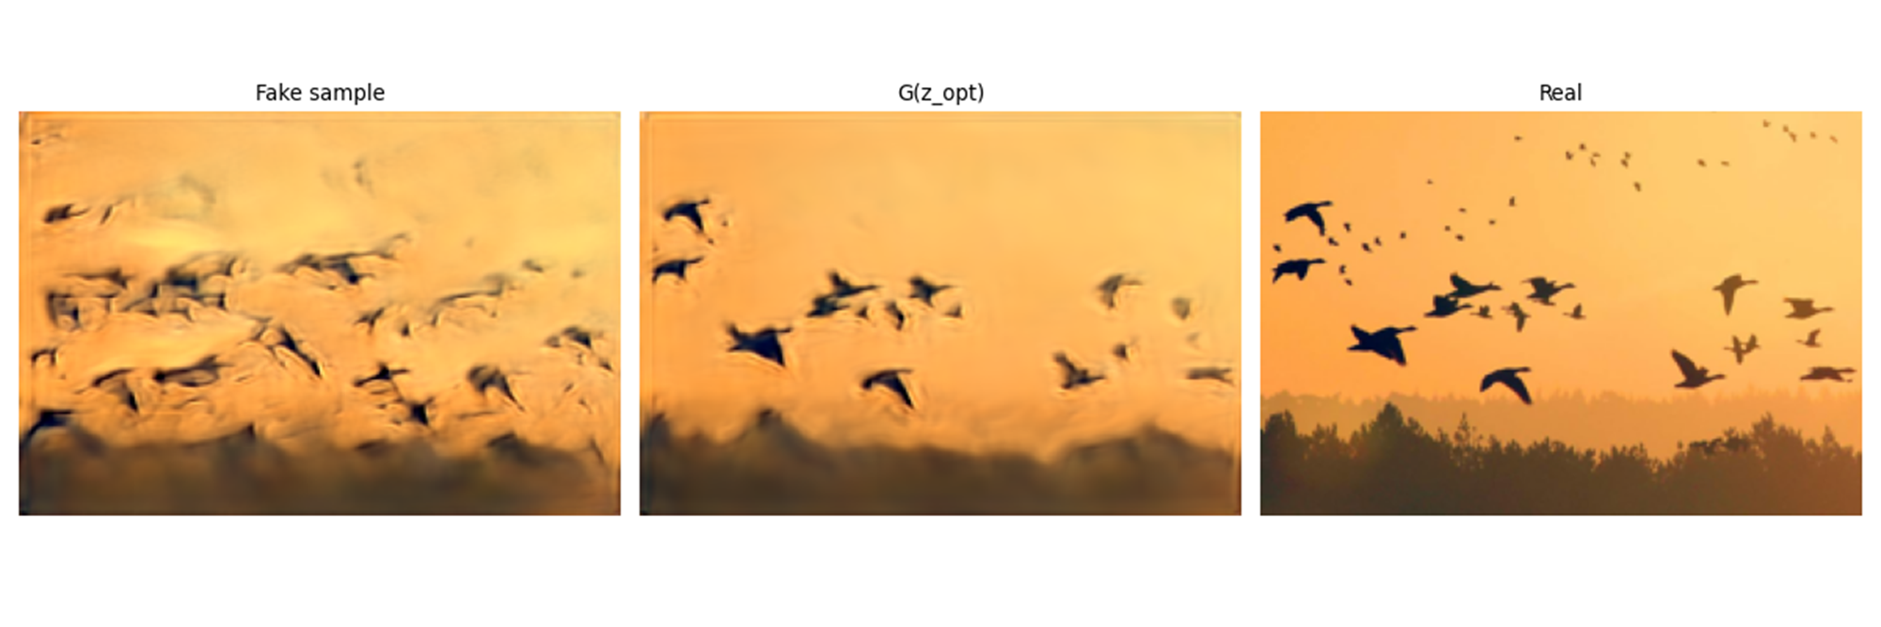
RESULTS : IMAGE GENERATION QUALITATIVE ANALYSIS SinGAN with FD cost
0
2
5
8

Slide 3
RESULTS : QUANTITATIVE ANALYSIS
SIFID (Singular Fréchet Inception Distance)
Mean FID distance between batch of 500 fake random generated samples and 1 real image
A lower score indicates:
Higher similarity
Better quality
More effective model
Unreliable results
Similar SIFID for default SinGAN and Fréchet SinGAN

Slide 4
Conclusion
In-depth comprehension of the SinGAN algorithm
Successful implementation yielding coherent results
Development of a less precise yet effective patch recovery method.
Constraints related to time and GPU resources
Future Research Directions:
Exploration of semi-optimal transport for enhancing edge effects
Hyperparameter tuning for the SinGAN with FD cost

